Slide 1
2021 US National Combustion Meeting Cantera Workshop
May 23, 2021

Slide 2
Agenda
Morning Session - Getting Started with Cantera
General Information
Community Resources
Installation options
Where to find examples
Adiabatic Flame Temperature Calculations

Slide 3
Agenda
Afternoon Session - Parallel Tracks
Using Cantera: Ignition Delays, Flame Speeds, and Other Applications
Afternoon: Bring Your Own Model: Using Cantera With Your Own Equations
Afternoon: Getting Started With Contributing To Cantera

Slide 4
Overview of Cantera
Property Calculator
Set state of your phase object(s)
Evaluate individual properties via function calls.
Canonical Simulations
Cantera comes pre-packaged with a number of simulation tools and examples for a limited set of classic problems
0-D reactors
1-D flames, flows, and reactors
These models take user inputs for intial/inlet conditions, reactor geometry, etc.
The model sets the state of Cantera objects and evaluating properties to provide terms required to solve/integrate conservation equations.

Slide 5
Overview of Cantera
Property evaluation for in-house simulation code
For more complex or novel simulations, the user writes their own simulation code.
Establishes a solution vector to describe the system state
Defines and codes conservation equations
Writes calls to Cantera to evaluate terms in the conservation equations

Slide 6
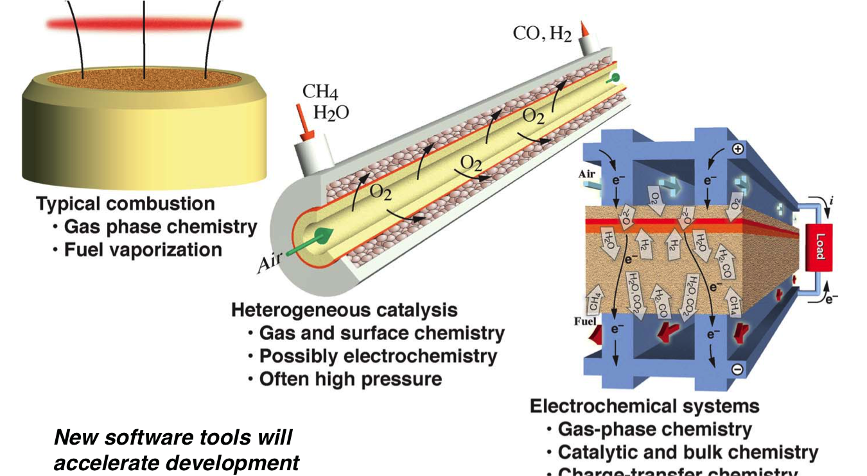
Application Areas
Apps.png

Slide 7
Cantera can be used in a wide variety of applications
Combustion
Electrochemistry
Surface chemistry
Non-ideal equations of state
Cantera’s strength is that it is (relatively) easy to add new functionality

Slide 8
Examples
Examples are available from the Cantera documentation in several formats
Python scripts: https://cantera.org/examples/python
Jupyter Notebooks: https://cantera.org/examples/jupyter
Matlab scripts: https://cantera.org/examples/matlab
C++: https://cantera.org/examples/cxx
Fortran: https://cantera.org/examples/fortran

Slide 9
Community Resources
https://cantera.org/community

Slide 10
Community Resources
Cantera is a fiscally-sponsored project with NumFOCUS
NumFOCUS is a non-profit umbrella organization that provides support for open-source scientific software
We would really appreciate your support for Cantera!
https://numfocus.salsalabs.org/donate-to-cantera/

Slide 11
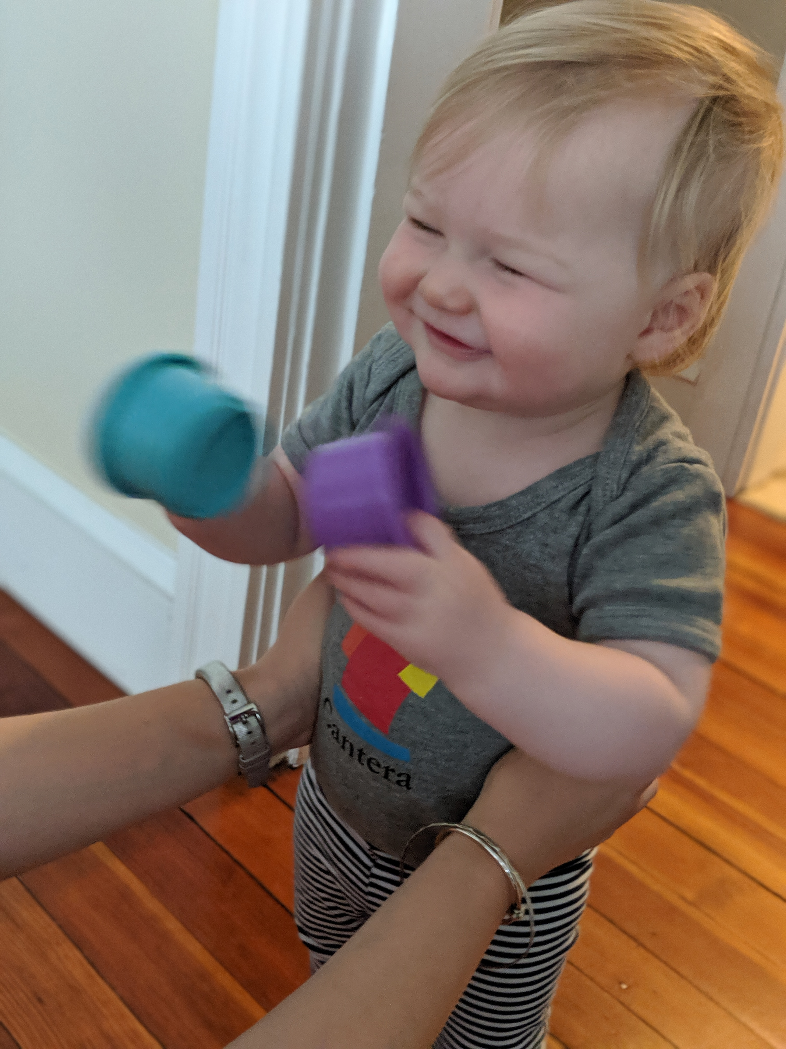
Plus, we have really cool shirts, mugs, hats, water bottles, onesies, and more!
https://shop.spreadshirt.com/numfocus/cantera+official+logo

